Slide 1
Revolutionizing E-Waste Management in Smart Cities with Blockchain Technology
Guide By: Presented By:
S. YogaDinesh - ME R. Hari Prasad – ( 920120104006 )
M. Sivabalan – ( 920120104028 )

Slide 2
ABSTRACT
This study revolves around the E-waste product dataset. With the proliferation of cloud services, there has been a surge in the number of data owners opting to store their encrypted data in the cloud. Concurrently, a significant number of data users engage in data retrieval activities. The approach is founded on blockchain technology. A Hybrid ECC and AES Algorithm are employed for the encryption and decryption of the dataset. Encrypted files are stored on the cloud server, and users conduct keyword-based searches using the algorithm. Users input encrypted queries based on keywords, which are then utilized for searching the encrypted cloud server. Upon locating relevant files based on the query, users can decrypt the files using specific keys, resulting in enhanced performance in terms of recall, ranking precision, and search time.

Slide 3
OBJECTIVES
The main objective is,
To performance Block chain.
To perform the, Encryption and Decryption with less data loss.
To implement the hybrid AES and ECC learning algorithm.
To enhance the performance analysis.

Slide 4
EXISTING SYSTEM
Employing a proxy server within a Cloud Service Provider (CSP) enhances search efficiency and reduces search time by employing a Boolean search mechanism in the proxy server.
The primary server facilitates simultaneous access for multiple users through a Deep Learning-based Neural Network, ensuring precise results.
A Trusted Authority is tasked with ensuring secure document retrieval for authorized users. The TA oversees dual security measures encompassing key management and the issuance of security devices.
Ensuring secure top k ranking is attained through Euclidean distance calculations, thereby enhancing the accuracy of document retrieval.

Slide 5
DISADVANTAGES
Encryption and decryption file on time high.
Along with that, data loss is more when compared with the other conventional methods.

Slide 6
PROPOSED SYSTEM
The adoption of cloud services has led to a surge in data owners storing their encrypted data on cloud platforms, paralleled by an equivalent or greater number of data users engaged in retrieval activities.
This approach is underpinned by blockchain technology.
A Hybrid ECC and AES Algorithm are utilized for the encryption and decryption of the dataset.
Encrypted files are securely stored on cloud servers, and users conduct keyword-based searches using an algorithm.
Users input encrypted queries based on keywords, which are then utilized for searching the encrypted cloud server.
Upon locating relevant files based on the query, the retrieval process is initiated to access the encrypted file related to the query data.
Users employ a specific key to decrypt files, leading to improved performance in terms of recall, ranking privacy, precision, and search time.

Slide 7
ADVANTAGES
Time taken to done the Encryption and decryption is very low, when compared with the other techniques.
Easy to retrieve the data from the cloud.
Data loss is low, in the receiver side during the decryption process.

Slide 8
FLOWCHART

Slide 9
Data set(E-wasting )
Input data
Tokenization, Lemmatization Removing punctuations
Preprocessing
Stop Words
Hybrid ECC and AES Algorithm
Encryption
Block chain
SHA-256 hashing algorithm
Cloud
Create Block Header
Query
SHA-256 hashing algorithm
Searching
Key (Hybrid ECC and AES Algorithm
) Multiple User
Block hash < target
Decryption
Create a New Block

Slide 10
3.1 ARCHITECTURE DIAGRAM

Slide 11
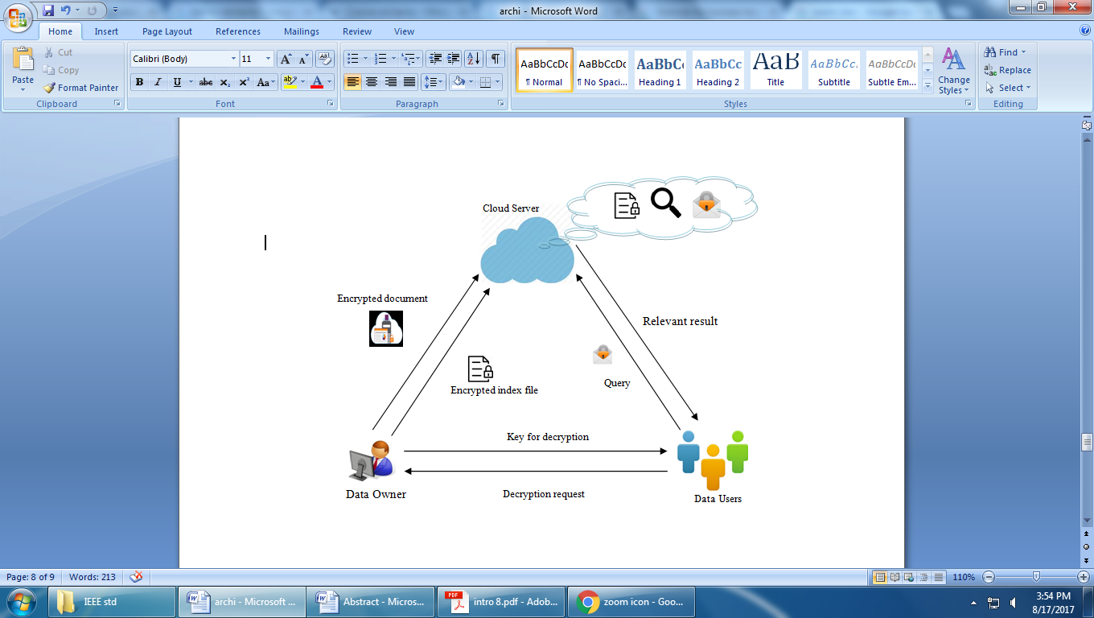
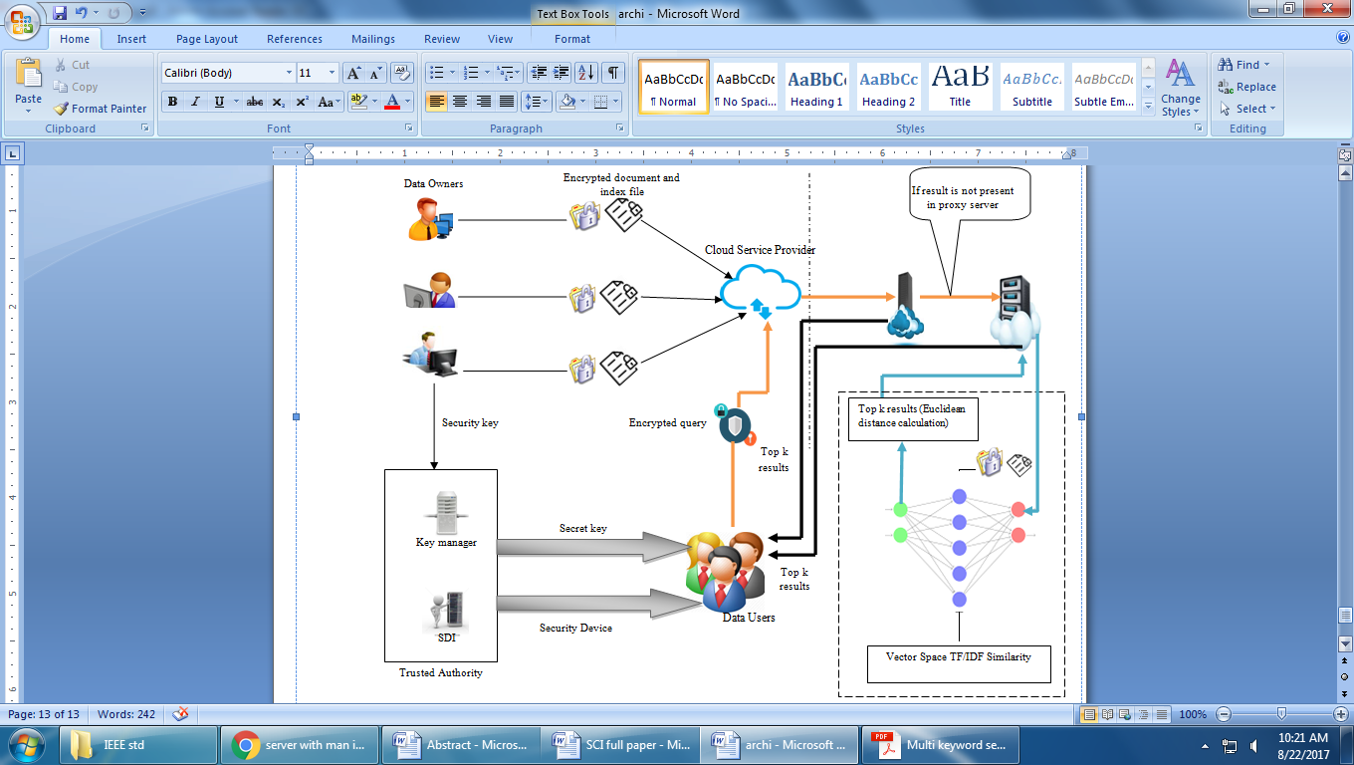
3.1 BLOCK DIAGRAM

Slide 12
USE CASE DIAGRAM
Python script
File Encryption
Searching
User
File Decryption
Logout

Slide 13
LITERATURE SURVEY
Title : Proficient Dual Secure Multi Keyword Search by Top k- Ranking based on Synonym Index and DNN in Untrusted Cloud
Year : 2018
Author : Aditi Gudadhe, Akanksha Parbat, Bhavana Wankhede, Brinda Darjee, Dr. Leena H.Patil
Methodology:
A secure ranking based multi keyword search using semantic index is being developed. Initially, owner builds an index file by semantic representation of keywords using Term Frequency/Inverse Document Frequency (TF/IDF). Security key is provided by Trusted Authority (TA) for decrypting the obtained results at the user side. TA manages dual security processes such as managing secret key and issuing security device to the data users. User query reaches proxy server, and it checks whether any frequent keyword matches with given query by Boolean Search. If not, query enters into the main server who stores all document and index files to obtain relevant result using Deep Learning Neural Network. In deep learning neural network, the query is processed with vector space model in order to retrieve the relevant documents.
Advantage:
encryption time and accuracy
Disadvantage:
It requires basic information about keyboard shortcuts used or where the keys are located.

Slide 14
LITERATURE SURVEY
Title: Secure Ranked Multi-Keyword Search Based on Modified Blowfish algorithm and AVL Tree in Untrusted Cloud Environment
Year : 2014
Author : G.Shoba, G.Anusha, V.Jeevitha, R.Shanmathi
Methodology:
This MB algorithm provides robustness against any intruding whereas the conventional blowfish algorithm insecure for many applications. To achieve a proficient search, every data owner’s index based on AVL tree is encrypted by way of additive order and the privacy-preserving family is formed. The cloud server is then permitted to combine these indexes effectually without knowing the index content. An Iterative Deepening Depth First Search (IDDFS) procedure is used to discover the matching file for the data user request
Advantage:
User query reaches proxy server, and it checks whether any frequent keyword matches with given query by Boolean Search.
Disadvantage:
User query reaches proxy server, and it checks whether any frequent keyword matches with given query by Boolean Search is not matching on retrieval file.

Slide 15
LITERATURE SURVEY
Title: Cyber Security Threats Detection in Internet of Things Using Deep Learning Approach
Year : 2014
Author :Farhan Ullah
Methodology:
This MB algorithm provides robustness against any intruding whereas the conventional blowfish algorithm insecure for many applications. To achieve a proficient search, every data owner’s index based on AVL tree is encrypted by way of additive order and the privacy-preserving family is formed. The cloud server is then permitted to combine these indexes effectually without knowing the index content. An Iterative Deepening Depth First Search (IDDFS) procedure is used to discover the matching file for the data user request
Advantage:
More taken time for Encryption
Disadvantage:
User Not matched Retrieval

Slide 16
LITERATURE SURVEY
Title: Encrypted multi-keyword ranked search supporting gram based search technique
Year : 2016
Author : Suresh M
Methodology:
Scheme that not only enable document keyword search but also supports linear, gram based and semantic searches. We construct a special tree-based index structure and propose a fuzzy Search Server that creates wild card based fuzzy keyword Set which overcome KGA (Keyword Guessing Attack) and provide efficient multi-keyword ranked search. KNN algorithm is used to encrypt the index and query. It also uses the relevance score calculation for ranking the documents.
Advantage:
More taken time for Encryption
Disadvantage:
It requires basic information about keyboard shortcuts used or where the keys are located.
Relevance score calculation for ranking the documents Ranking Very low

Slide 17
MODULES
Cyber Security Dataset
Hybrid ECC and AES Algorithm
Block chain
Query search
Key Generation
Cloud Storage
Performance Metrics

Slide 18
MODULES DESCRIPTION

Slide 19
DATA SELECTION
, networks, programs, devices, and data.
Its goal is to reduce tCyber security is the use of technologies, processes, and controls to defend against cyber-attacks on systemshe risk of cyber-attacks and to protect against unauthorized use of systems, networks, and technologies.
Cyber security Protocols Reference and Keywords.
In this step, we have to load the data with the help of panda’s packages.

Slide 20
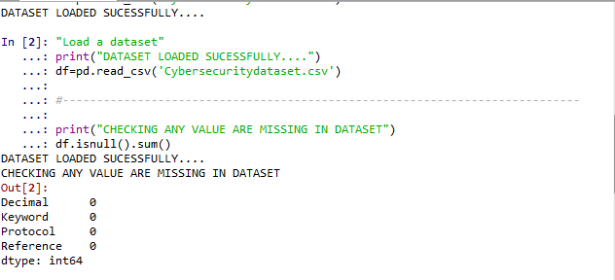
DATA SELECTION

Slide 21
DATA PREPROCESSING
Data pre-processing is the process of removing the unwanted data from the dataset.
Pre-processing data transformation operations are used to transform the dataset into a structure suitable for machine learning.
Missing data removal: In this process, the null values such as missing values and Nan values are replaced by 0.
Encoding Categorical data: That categorical data is defined as variables with a finite set of label values.

Slide 22
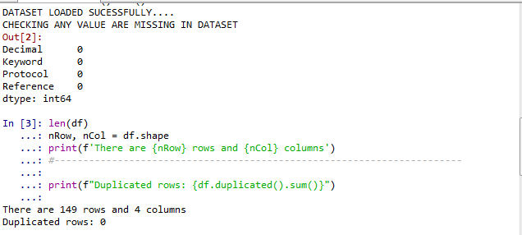
DATA PREPROCESSING

Slide 23
BLOCK CHAIN
Block chain is a system of recording information in a way that makes it difficult or impossible to change, hack, or cheat the system.
A block chain is essentially a digital ledger of transactions that is duplicated and distributed across the entire network of computer systems on the block chain. Each block in the chain contains a number of transactions, and every time a new transaction occurs on the blockchain, a record of that transaction is added to every participant’s ledger. The decentralised database managed by multiple participants is known as Distributed Ledger Technology (DLT).
Block chain is a type of DLT in which transactions are recorded with an immutable cryptographic signature called a hash

Slide 24
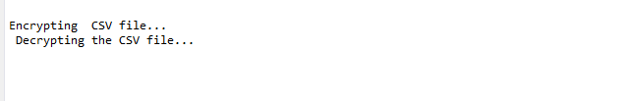
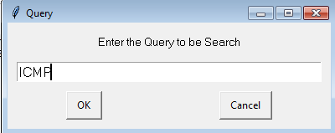
Hybrid ECC and AES Algorithm
ECC Elliptic Curve Cryptograph Algorithm based on Public and Private Key
ECC and AES based on Encrypted data
The quick explanation is that keys using Elliptic Curve Cryptography (ECC) are asymmetric (public and private), whereas AES-256 uses a symmetric cypher (key)
ECC and AES based on it Public and Private key
Hybrid AES and ECC based on 128 bit key Generated For Encrypted data Wise

Slide 25
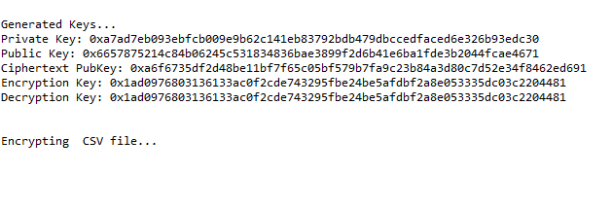
KEY GENERATION
Hybrid ECC and AES based on 128 bit key Generated For Encrypted data Wise
A encryption system is designed by combining the characteristics of the AES and ECC
Which Can solve Security Problem itself
Efficiently realize the information, data encryption, signature, and identity verification.

Slide 26

CLOUD ME
Encrypted File Will be Stored in data for Security purpose
A cloud computing model in which data is stored on the Internet via a cloud computing provider who manages and operates data storage as a service
Cloud Server will be used on Cloud me Software

Slide 27
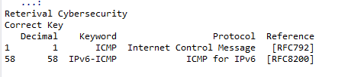
RETRIEVAL FILE

Slide 28
SYSTEM REQUIREMENTS
SOFTWARE REQUIREMENTS:
O/S : Windows 7.
Language : Python
Front End : Anaconda Navigator – Spyder
HARDWARE REQUIREMENTS:
System : Pentium IV 2.4 GHz
Hard Disk : 200 GB
Ram : 4GB

Slide 29
CONCLUSION
Hybrid ECC and AES Algorithm using the Encrypted and Decrypted the dataset
Encrypted File will be Stored in Cloud Server and User based on Semantic Searching method Algorithm.
User based keyword Entering is done to retrieve the corresponding data file from the cloud storage.
Finally Retrieve the Related File based on Query.
This will easily Find out Cyber security Problem like, the fault file will be detected.

Slide 30
Thank You…

